Slide 1
SSW-810: Software Engineering Tools and Techniques
Containers:
Tuples, Dictionaries and Sets
Dr. Raz Saremi
Software Engineering
School of Systems and Enterprises
This Lecture is based on material from Prof. Jim Rowland

Slide 2
Acknowledgements
This lecture includes material from
“How to Think Like a Computer Scientist: Learning with Python 3 (RLE)”, Peter Wentworth, Jeffrey Elkner, Allen B. Downey, and Chris Meyers,
http://openbookproject.net/thinkcs/python/english3e/
And
“Introducing Python”, Bill Lubanovic, ISBN-13: 978-1449359362
http://proquest.safaribooksonline.com/book/programming/python/9781449361167
https://docs.python.org/3/library/stdtypes.html

Slide 3

Today’s topics
Lambda Expressions
Containers
Lists
Tuples
Dictionaries
Counter
DefaultDict
Sets
Frozensets

Slide 4
lambda: anonymous functions
lambda expressions are one line, anonymous functions
lambda parameters: expression
Is equivalent to
def <anon>(parameters): return expression
expression must be a pure expression
No assignment, if, while, for, try, return, … statements
Lambda expressions are fairly uncommon in Python 3.*
lambda was popular before list comprehensions
Used frequently with map(), filter(), and reduce()
Popular when using Python as a Functional language

Slide 5
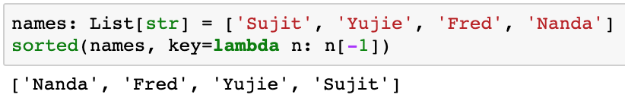
When to use lambda?
lambda expressions are commonly used to change the default behavior of sort
Sort names by the last character in the name
key must be a function
Simpler than
def last_char(s):
return s[-1]

Slide 6
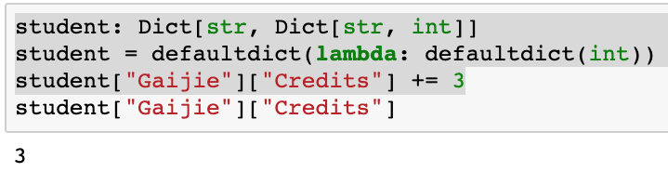
When to use lambda?
lambda expressions are commonly used to define the factory function in a defaultdict
The factory must be a function so lambda is a good solution

Slide 7
Containers
Python provides several different types of containers
Lists – ordered, arbitrary values and mutable – [1, 2, 3]
Tuples - like list, but immutable – (1, 2, 3) or 1, 2, 3
Dictionaries – unordered Key/Value pairs
– {‘one’:1, ‘two’:2, ‘three’:3 }
Sets - {1, 2, 3 }
Like lists, but with only unique values
Like lists, but unordered
Like dictionaries with keys, but no values
These containers are fundamental in Python and are used in most Python programs
Python 3.7+ guarantees dict ordered by insertion of keys

Slide 8
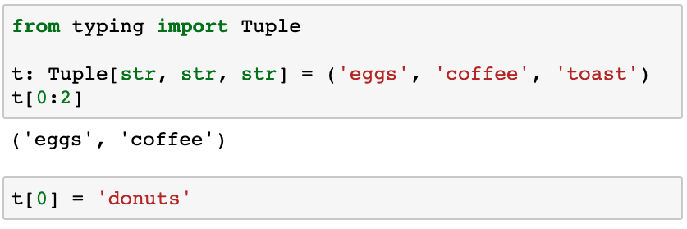
Indices and slices with tuples
Indices and slices work the same with tuples as with strings and lists
Note: parens, not brackets
Tuples can’t be changed

Slide 9
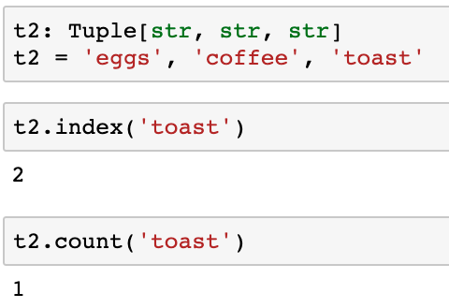
Tuple methods
Many of the list methods also work with tuples
None of the list methods that add, change, or delete elements are defined for tuples because tuples are immutable
Parens are optional
Tuple.index(value) and tuple.count(value) work just like lists

Slide 10
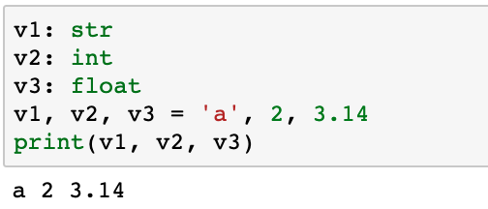
Tuple unpacking
Tuples enable multiple assignments in a single statement

Slide 11
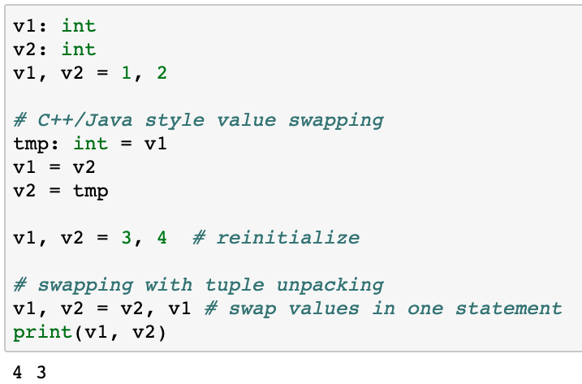
Value swapping with tuple unpacking

Slide 12
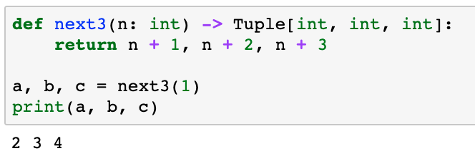
Returning multiple values with tuple unpacking
Tuples are ideal for returning multiple values from a function

Slide 13
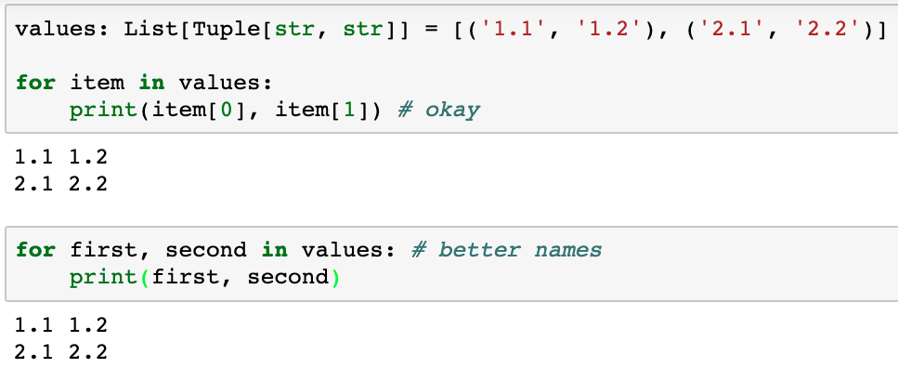
Assigning multiple variables with tuple unpacking
Tuple unpacking improves readability when assigning multiple variables
Syntactically correct but hard to read
Easier to read and understand

Slide 14
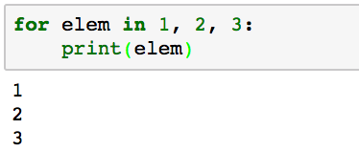
Iterating through tuple elements
for loop iterates through tuple elements
Comma specifies a tuple

Slide 15
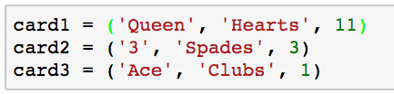
Named Tuples
Tuples are useful for grouping collections of values
Analogous to a class with values, but no methods
Represent a deck of cards with value, suit, and rank
Conveniently group data fields but need to remember order of fields

Slide 16
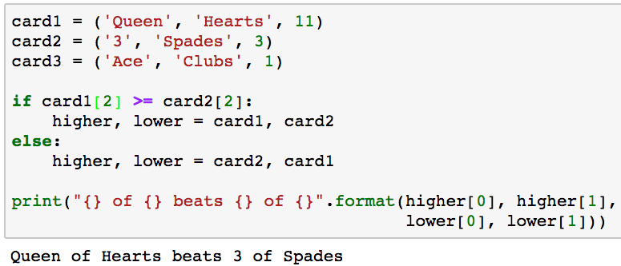
Named Tuples
Compare two cards to find the “higher” card
Which field is at index 2?
What’s the first, second, and third value in the tuple???

Slide 17
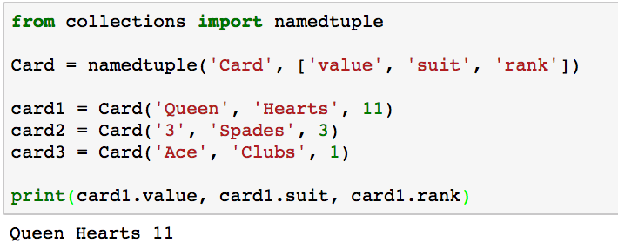
collections.namedtuple
namedtuple allows us to use tuples like classes without methods
Access fields by name using “dot” notation

Slide 18
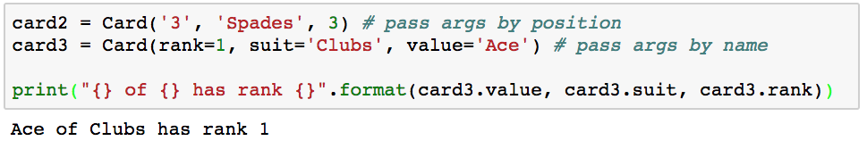
collections.namedtuple
Create instances of namedtuple by field names
Specify value rather than position

Slide 19
collections.namedtuple syntax
MyType = namedtuple(‘MyType’, [list of fields])
namedtuple allows you to access values by name rather than position

Slide 20
When/why to use tuples
Tuple unpacking is great for…
Assigning multiple values
Returning multiple values from a function
Swapping values
Tuples are more efficient than lists
Tuples protect your data from unintentional changes
Tuples can be used as keys in dicts

Slide 21
Dictionaries
Many applications require key/value pairs
How many times does a word occur?
Mapping from one value to another
“one” ➔“uno”, “two” ➔“dos”, …
Book index (on which pages does a word occur?)
“Python” ➔ [1, 4, 17, 19, 201]
Dictionaries are a perfect solution for these tasks!
Dictionaries map keys to values
Dictionaries provide associative arrays/hash tables

Slide 22
Finding an item in a collection
I need to find my friend Nanda
I can knock on every door until I find him …
… or I can look up his address and go directly to the right door
Dictionaries map keys to values
Nanda Apt 5B

Slide 23
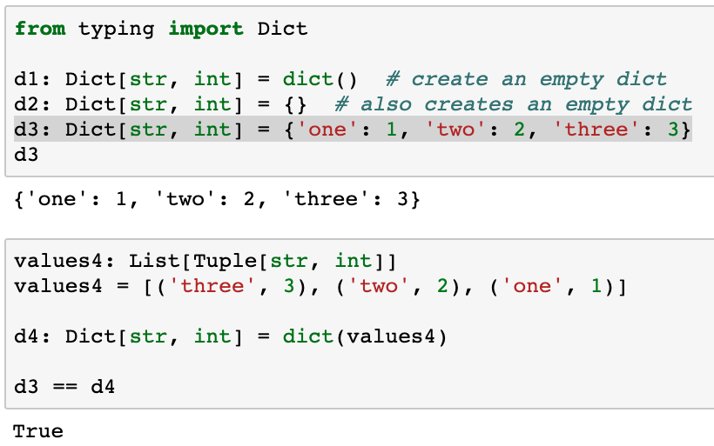
Create a dictionary
Initializing a dictionary requires pairs of keys and values
Dictionaries are stored in order the keys are added as of Python 3.7

Slide 24
dict
Keys can be any hashable value:
str, int, float, tuple, frozenset
Cannot use a list or set as a dictionary key
Lists and sets may change so the hash value could change
Values can be any type, even dictionaries
Perfect for database types with rows and columns
Keys and values may be heterogeneous
Accessed by value, not position (like strings, lists, tuples)
Fast, random access to values based on keys

Slide 25
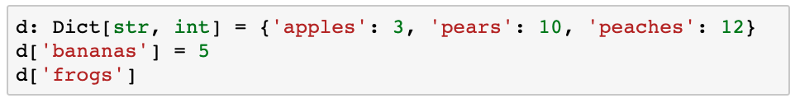
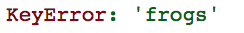
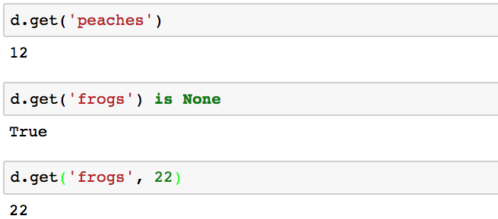
Accessing and setting values
Add new key ‘bananas’ with value 5
‘bananas’ is not a key yet – add a new key and value
Access value of unknown key ‘frogs’ so raise KeyError
dict.get(key) gets the value associated with ‘key’, but does not add ‘key’ to the dict
‘frogs’ is still not a key, but no exception
If ‘frogs’ is not a key, then return 22. ‘frogs’ is NOT added as a key

Slide 26
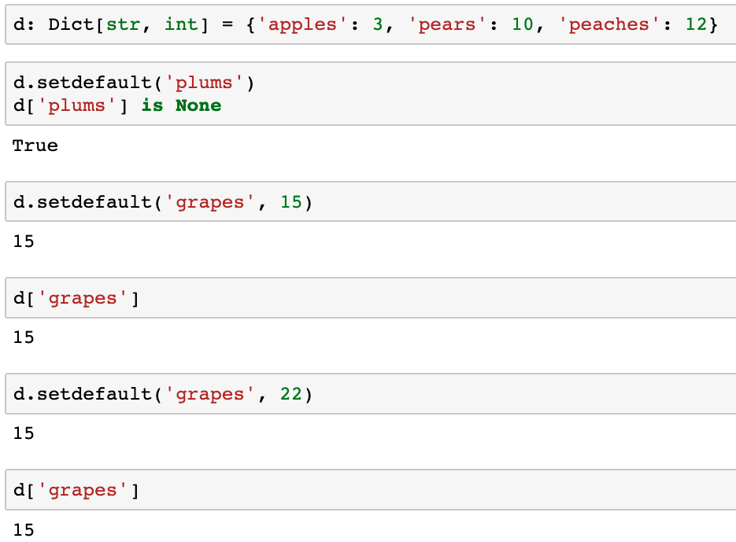
setdefault(key, value=None)
Set dict[key] = value if key not in dict
Set the value for a specific key if the value is not already set
‘plums’ is not d: d[‘plums’] = None
‘grapes’ is not in d so d[‘grapes’] = 15
‘grapes’ is in d so don’t change d[‘grapes’]

Slide 27
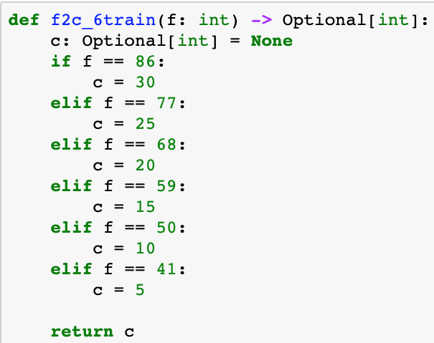
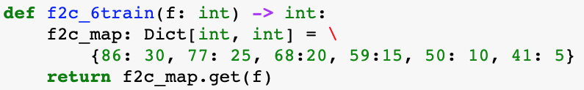
Replace long if/elif/else blocks with dict
Replace this long, error prone if statement with a dict

Slide 28
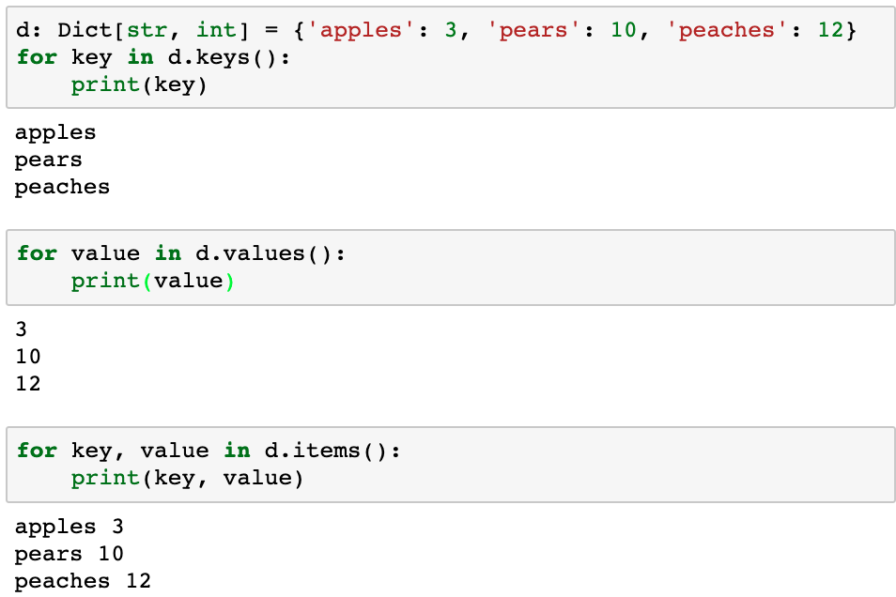
Iterating over a dictionary
for key in d:
is equivalent to
for key in d.keys():
dict.items() returns a sequence of (key, value) dict.keys() returns a sequence of keys
dict.values() returns a sequence of values

Slide 29
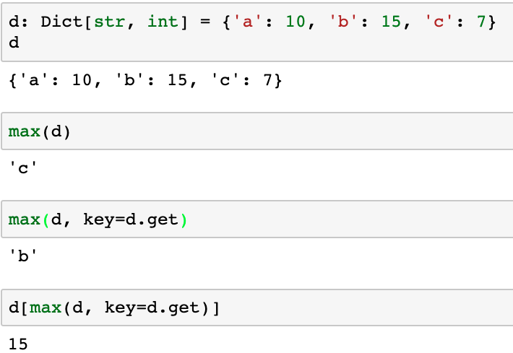
Finding dict’s max key or key associated with the max value
How can we find the max/min key in a dictionary?
Return the max key value
Return the key with the max value:
max(dict, key=dict.get) returns the key associated with the max value in dict

Slide 30
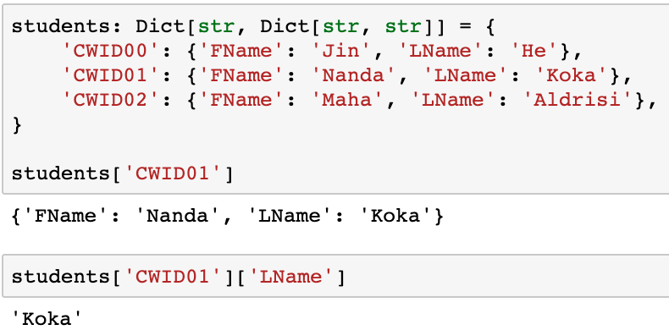
Implementing tables with nested dicts
CWID | FName | LName
CWID00 | Jin | He
CWID01 | Nanda | Koka
CWID02 | Sally | Fields

Slide 31
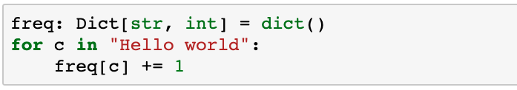
Use dicts to count items: Attempt 1
Calculate the frequency of each item in a sequence
‘H’ is not a key in freq, so raise exception

Slide 32
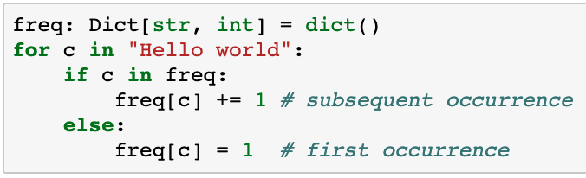
Use dicts to count items: Attempt 2
Calculate the frequency of items in a sequence
This solution is correct, but we can do better
c is a key, so increment the count
c is not a key, so add key and value

Slide 33
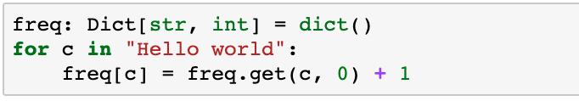
Use dicts to count items: Success!
Calculate the frequency of each character
This solution is correct, but we can do better
If c is already a key,
then get the value
else use 0.
Then Increment the value

Slide 34
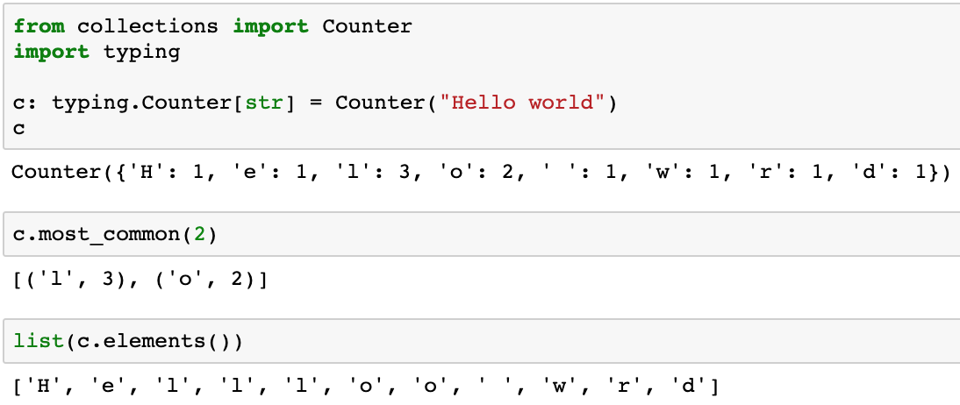
Special case dictionaries: Counter
Counting occurrences of some item is a common task
e.g. count characters, words, list elements, etc.
Unusual type hint: both class and type hint share name
The parameter can be any sequence, e.g. string, list, tuple, …
Return the N most frequent items
Return an iterator of all of the elements in undefined order

Slide 35
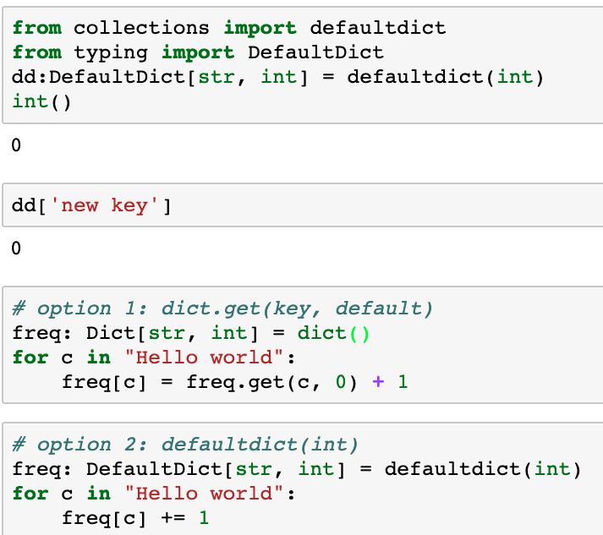
Special case dictionaries: defaultdict
collections.defaultdict(factory) assigns a default value from the specified factory if the key is not found
Int() returns 0 which gives a default of 0
The default value of any new key is 0
These two options do the same thing.
Which is easier to read?
If c is already a key, then return freq[c]
else freq[c] = 0, then increment the value

Slide 36
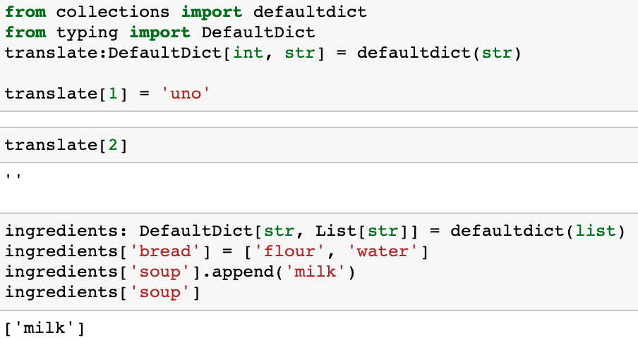
defaultdict(factory)
You can define a defaultdict with any type
If the key does not appear in the dict, then add they key to the dict and return the default value specified by the factory
Default value is an empty list
Safe to append because value is a list by default, even if key hasn’t been added

Slide 37
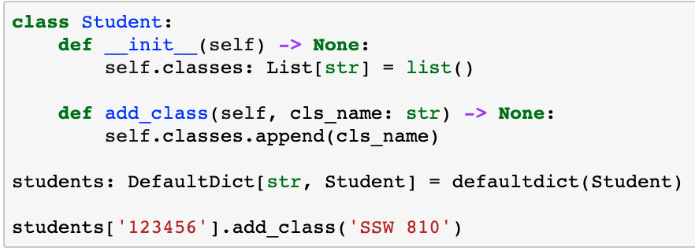
defaultdict(factory)
You can define a defaultdict with classes
The class __init__(self) must take no additional arguments

Slide 38
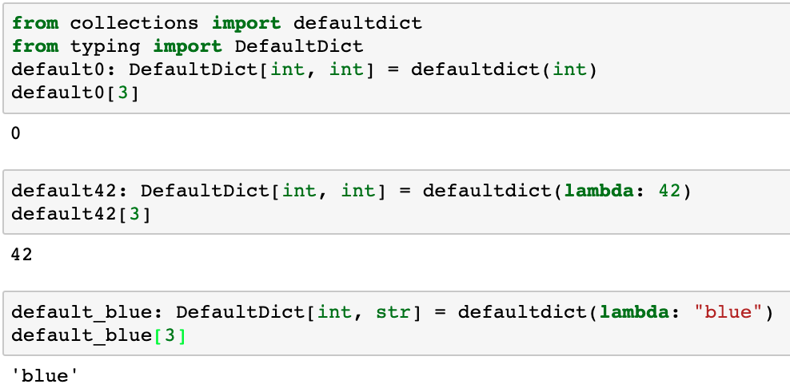
defaultdict(factory)
How to specify a different default value?
lambda defines an anonymous function
The default value is integer 42
The default value is string ‘blue’

Slide 39
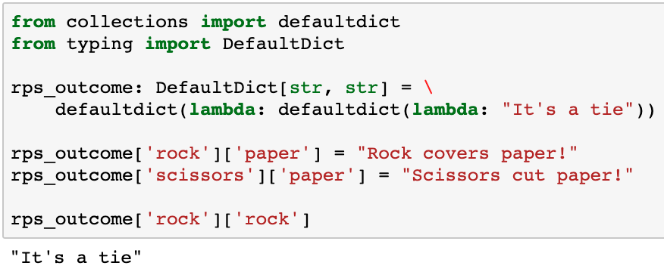
Defaultdict with multiple keys
What if we want a defaultdict with multiple keys?
rps_outcome[human] is a defaultdict(lambda: ”It’s a tie!”)
This provides a default outcome for unspecified combinations of human and computer moves

Slide 40
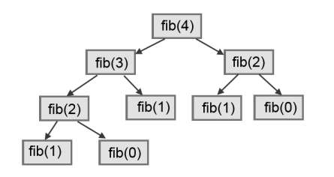
Memoization/caching
Memoization speeds up calculations by creating and maintaining a cache of previous results
Don’t recalculate each time, just retrieve it from the cache
Dictionaries are a great way to implement caches
Examples: recursive factorial, recursive Fibonacci
✔
Call | Count
fib(4) | 1
fib(3) | 1
fib(2) | 2
fib(1) | 3
fib(0) | 2
✔
✔
✔
✔
✔
✔
Why didn’t this call fib(0)?

Slide 41
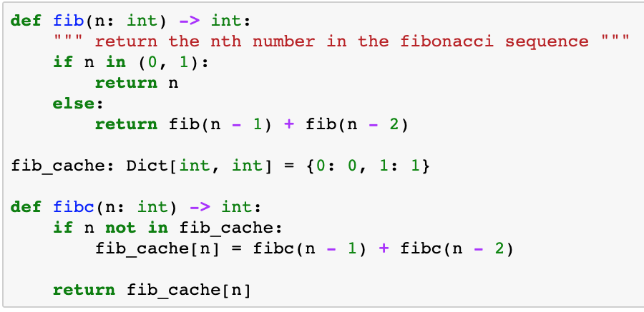
Memoizing Fibonacci: Performance
Populate the cache
The cache solution is > 2 million times faster for fib(40)
Approach | Calls | Time (Seconds)
fib(40) | 331M | 74.59
fibc(40) | 78 | 0.00033

Slide 42
Sets
A set is like a dictionary with keys, but no values
Each value can appear only once
Values are unordered
Values can be any hashable type (int, float, string, tuple, …)
Sets cannot contain lists or sets because they are mutable
Set values can be heterogeneous
Sets include methods for set operations
A
B
C

Slide 43
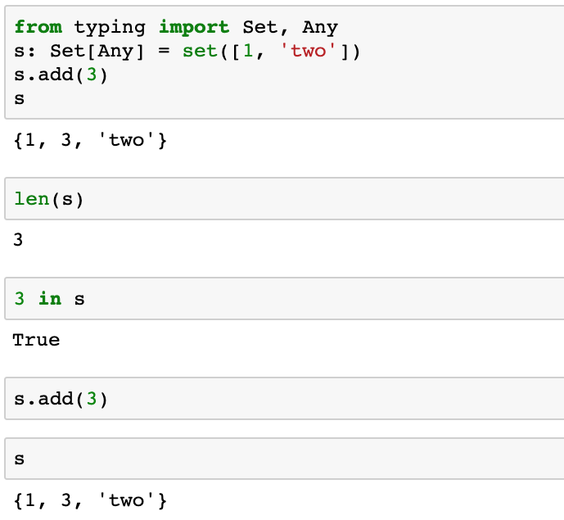
Set methods
Note the order is undefined
Wait!!! 3 is already a member of the set s! Adding an element that is already a member of the set is a no-op. Adding a duplicate does not raise an exception

Slide 44
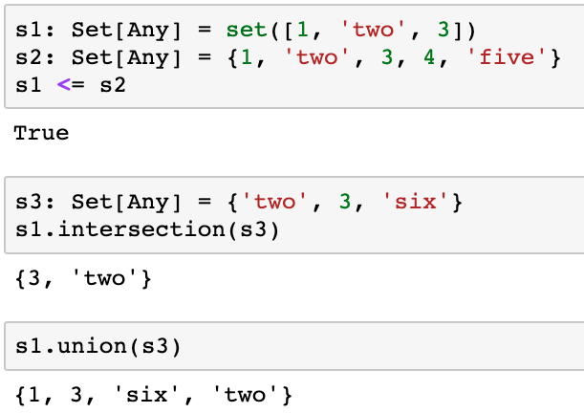
Set methods from high school math
Create a set from a sequence
Use curly brackets to define a new set,
like a dictionary without keys
Is s1 a subset of s2?
s1 s3
s1 s3

Slide 45
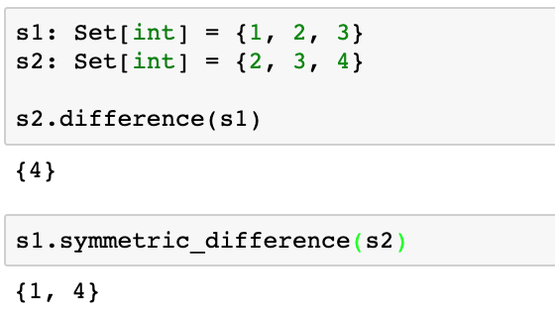
Set methods from high school math
Elements in s2, but not in s1
Elements in s1 or s2, but not both

Slide 46
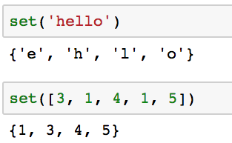
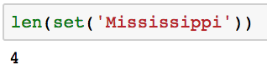
Finding unique items
Sets provide a convenient way to identify the distinct values from an iterator, e.g. string, list, tuple
How many distinct characters in “Mississippi”?

Slide 47
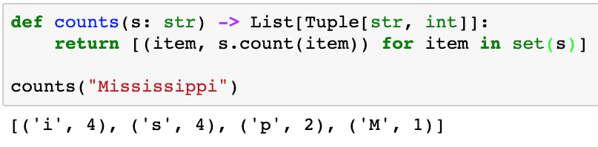
Write a program…
Given a sequence, s, return a list of lists where each inner list is a pair of the unique values in s and the number of occurrences of each value.
E.g. counts('Mississippi') returns [('M’, 1), ('i’, 4), ('s’, 4), ('p’, 2)]
Beware: Sets are unordered so you may need to sort the result to compare in test cases

Slide 48
frozenset
A frozenset is an immutable set
The same operations as a set except the items in the set can’t change
Can’t add new items to the set
Can’t delete items from the set
frozenset is hashable so it can be used as a dictionary key

Slide 49
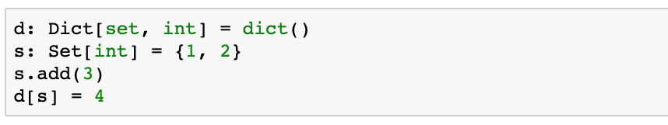
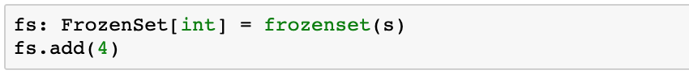
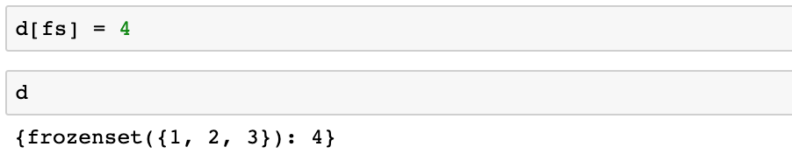
frozenset as a dictionary key
s is a set and is mutable
Dictionary keys must be hashable items
frozensets are not mutable
frozensets are hashable and can be used as dictionary keys

Slide 50
When to use which container?
Lists
Ordered items of any type
Duplicates are fine
Add to or delete from beginning or end
Great for stacks (LIFO) and queues (FIFO)
Tuples
Immutable version of lists
Grouping multiple related values as a single item
Returning multiple values from a function
Tuple unpacking for multiple assignments or swapping values
Lightweight classes without methods

Slide 51
When to use which container?
Dictionary
Key/Value pairs
Good when associating information with a key
Great for look up tables
Great for counting distinct elements
Replacing long if/elif/else blocks
Sets
Great any time you need set operations
Easy to identify distinct elements from an iterator, e.g. string, list, tuple

Slide 52

Questions?

